Slide 1
South Central
HIINergy Partners
Six states partnering for quality and patient safety through the Hospital Improvement Innovation Network
“Strategies for Getting Started
in our new HIIN”
January 25, 2017

Slide 2

Welcome and opening remarks
South Central HIINergy Partners
Agenda
January 25, 2017
  Welcome and overview
  Brief updates from State Leads
  Hospital sharing:
  “Getting Started in HIIN”
  Discussion and next steps
  Upcoming events and opportunities
  Contact Us
Agenda
Introductions
Announcements
Hospital Improvement Innovation Network

Slide 3

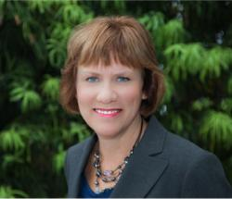

Introductions
 | Pamela Brown, RN, BSN, CPHQ Vice President of Quality and Patient Safety Arkansas Hospital Association with Kansas, Louisiana, Missouri, Oklahoma and Texas
 | Jackie Conrad RN, BS, MBA, RCC Improvement Adviser Cynosure Health
 | Joel Anderson, BBA Quality Research Analyst Jefferson Regional Medical Center

Slide 4
Webinar features
We encourage everyone to dial in on the phone line to engage in verbal collaboration with others on the call:
Participant Dial In & Passcode: Dial In 1-800-680-9685
Passcode: SP Call
You may also utilize the chat box to give your input to questions posed to the group or to ask a question
The slides can be downloaded from the box below titled “Files”. Highlight the file and then click download.

Slide 5
Purpose
The South Central HIINergy Partners is a group of six geographically proximal state hospital associations (SHA) that have partnered together to create synergy and an enriched virtual learning experience for participating HIIN hospitals as we work together with shared aims in achieving a 20% reduction in all-cause harms and a 12% reduction in all-cause readmissions.

Slide 6
Creating HIINergy together!
State | Number of Hospitals in HIIN
Arkansas | 53
Kansas | 113
Louisiana | 95
Missouri | 74
Oklahoma | 48
Texas | 115
TOTAL | 498

Slide 7
Let’s hear from you
We are glad you have joined us. Which is your state?
Arkansas
Kansas
Louisiana
Missouri
Oklahoma
Texas
Hospital Improvement Innovation Network

Slide 8
Creating HIINergy together!
Mark your calendars!
Bi-monthly HIINergy webinars will take place on 4th Wednesdays from 10 to 11 a.m. CT.
Links to pre-register for each webinar will be provided by your state lead.
2017 Schedule | Tentative HIIN Topics | State Lead
January 25 | Getting Started | Arkansas
March 22 | Up Campaign | Oklahoma
May 24 | Patient and Family Engagement | Louisiana
July 26 | Transforming Care at the Bedside | Texas
September 27 | Equity and Diversity | Kansas
November 15 | Sepsis | Missouri

Slide 9
Announcements
Don’t forget to complete your hospital’s Needs Assessments. Work with your state’s HIIN contact on specifics.
Baseline data for all measures should be submitted as soon as possible. Your state’s HIIN may be submitting for you or your individual hospital may be submitting to CDS. Follow your state-specific instructions.
Have you signed up for the topic specific list serves? If not please do so by going to
www.hret-hiin.org/inc/dhtml/listserv.dhtml

Slide 10
State Partner Updates
South Central HIINergy Partners
January 25, 2017
  Arkansas
  Pam Brown, Arkansas Hospital Association
  Kansas
  Michele Clark, Kansas Healthcare Collaborative
  Louisiana
  Michelle Smith, Louisiana Hospital Association
  Missouri
  Alison Williams, Missouri Hospital Association
  Oklahoma
  Patrice Greenawalt, Oklahoma Hospital Association
  Texas
  Karen Kendrick, Texas Hospital Association
Hospital Improvement Innovation Network

Slide 11
State HIIN Hospital Comparison
 | AR | KS | LA | MO | OK | TX
Total # Hospitals in State | 81 | 136 | 140 | 145 | 132 | 379
# Hospitals in HIIN | 53 | 113 | 95 | 74 | 48 | 115
Academic Hospitals | 1 | 0 | 5 | 0 | 2 | 1
Rural Hospitals | 37 16 CAH | 82 | 60 | 43 25 CAH | 31 16 CAH | 71 33 CAH
# Enrolled in a Fellowship | 12 | 38 | 16 | 37 | 29 | 27

Slide 12




Arkansas HIIN
Contact: Pam Brown, pbrown@arkhospitals.org
Vice President of Quality and Patient Safety
Director of Quality and
Patient Safety
Quality Specialist
Administrative Assistant

Slide 13
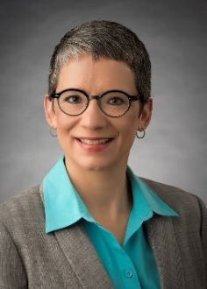
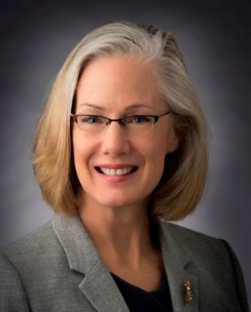
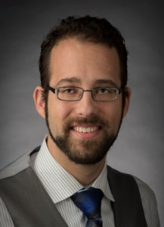

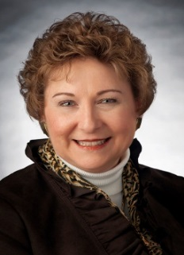

KHC HIIN
Contact: Michele Clark, mclark@khconline.org
Kansas Healthcare Collaborative HIIN Team
Kendra Tinsley
Executive Director
ktinsley@khconline.org
Michele Clark
Program Director
mclark@khconline.org
Rob Rutherford
Senior Health Care Data Analyst
rrutherford@khconline.org
Toni Dixon
Communications Director
tdixon@khconline.org
Rhonda Lassiter
Executive Assistant
rlassiter@khconline.org
Alyssa Miller
Project Assistant
amiller@khconline.org

Slide 14

Louisiana HIIN
Contact: Michelle Smith, msmith@lhaonline.org
Michelle Smith
Quality Program Manager
Louisiana Hospital Association
Research and Education Foundation
9521 Brookline Ave.
Baton Rouge, LA 70809
msmith@lhaonline.org
225-928-0026

Slide 15


Missouri HIIN
Alison Williams MBA-HCM, RN, BSN
Vice President of Clinical Quality Improvement
Missouri Hospital Association
awilliams@mhanet.com
573/893-3700, ext. 1326
Jessica Rowden MHA, RN, BSN
Director of Clinical Quality
Missouri Hospital Association
jrowden@mhanet.com
573/893-3700, ext. 1391

Slide 16
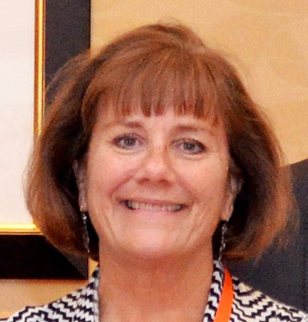
Oklahoma HIIN
Patrice Greenawalt, RN, MS
Clinical Initiatives Manager
Oklahoma Hospital Association
4000 Lincoln Boulevard
Oklahoma City, OK 73105
pgreenawalt@okoha.com
405/427-9537

Slide 17
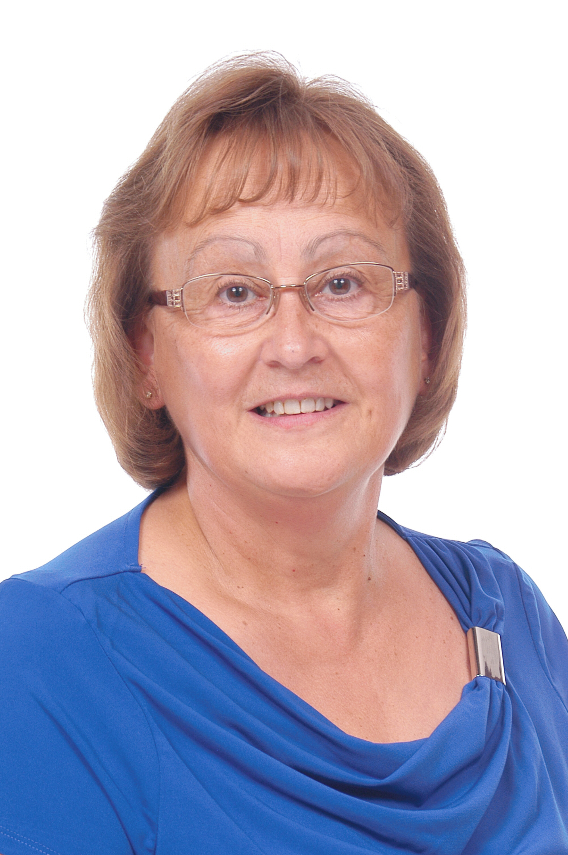
Texas HIIN
Contact: Karen Kendrick, email
Karen Kendrick, RN, MSN
Director, Clinical Initiatives
Texas Hospital Association Foundation
1108 Lavaca, Suite 700
Austin, TX 78701
kkendrick@tha.org
512/465-1091

Slide 18
Let’s hear from you
Polling Question
Where on you in the process of the HIIN work?
Forming a team to planning
Activity with little to no change
Modest improvement
Significant improvement to sustainable results
Outstanding sustainable results
Hospital Improvement Innovation Network

Slide 19
Getting Started in Our New HIIN
South Central HIINergy Partners
January 25, 2017
Presented by:
Jefferson Regional Medical Center
Pine Bluff Arkansas
Facilitated by:
Jackie Conrad
Improvement Advisor
Cynosure Health
Hospital Improvement Innovation Network

Slide 20
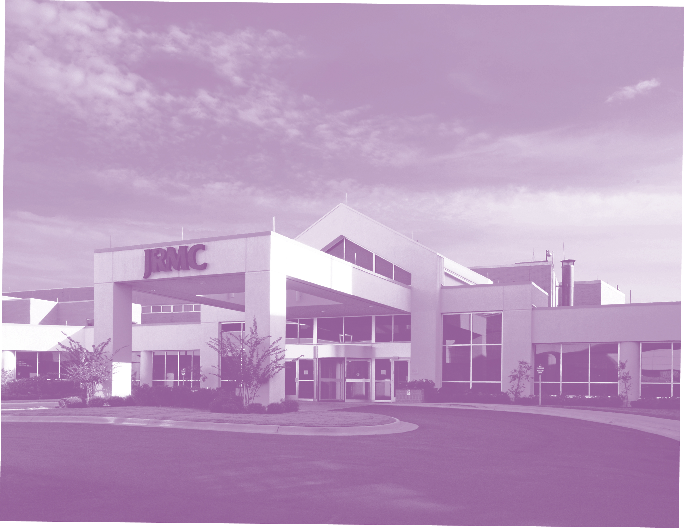
Closer to home!
HIIN: Getting Started
Presented By: Joel Anderson, BBA
Quality Research Analyst
HIIN Project Lead
Quality Resource Management Dept.
Jefferson Regional Medical Center

Slide 21

South Central HIINergy Partners

Slide 22
Organizing for Success
Multi-disciplinary teams for each HIIN topic
    Meet Bi-monthly with HIIN oversight project lead to strategize plans and track progress
HIIN Team Composition
    Membership from nursing, infection control, quality informatics, corporate, education, surgical services and pharmacy depts.
    Each team has an assigned administrative leader and physician liaison.
    Teams meet on a weekly, bi-weekly, or monthly basis depending on the individual topic.

Slide 23
Organizing for Success Cont.
Created a HIIN Share Drive
    Change Packages & Checklists
    PI Tracking Tool Spreadsheet
    Virtual Event Webinars- Slide Presentations, Flyers, Agenda’s
    Encyclopedia of Measures
    Team Meeting Notes, Agenda’s & Sign In Sheets
    AHA/HRET Collaborative Assessment Scale

Slide 24
Hospital Improvement Innovation Network (HEN 3.0) PI Tracking Spreadsheet
EXAMPLE
a
Example

Slide 25
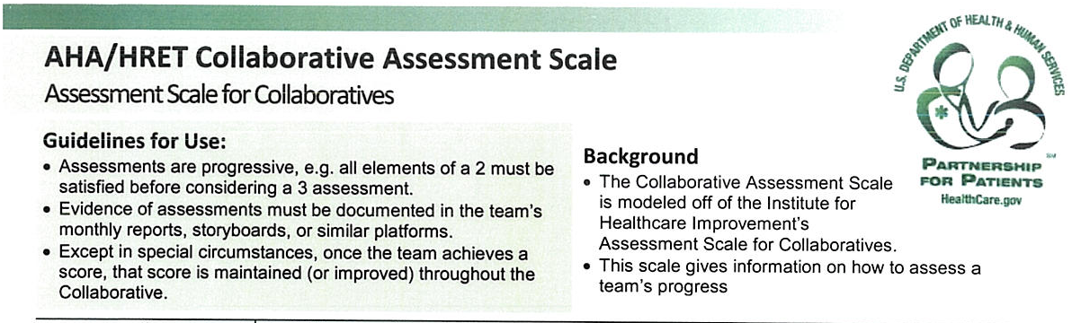
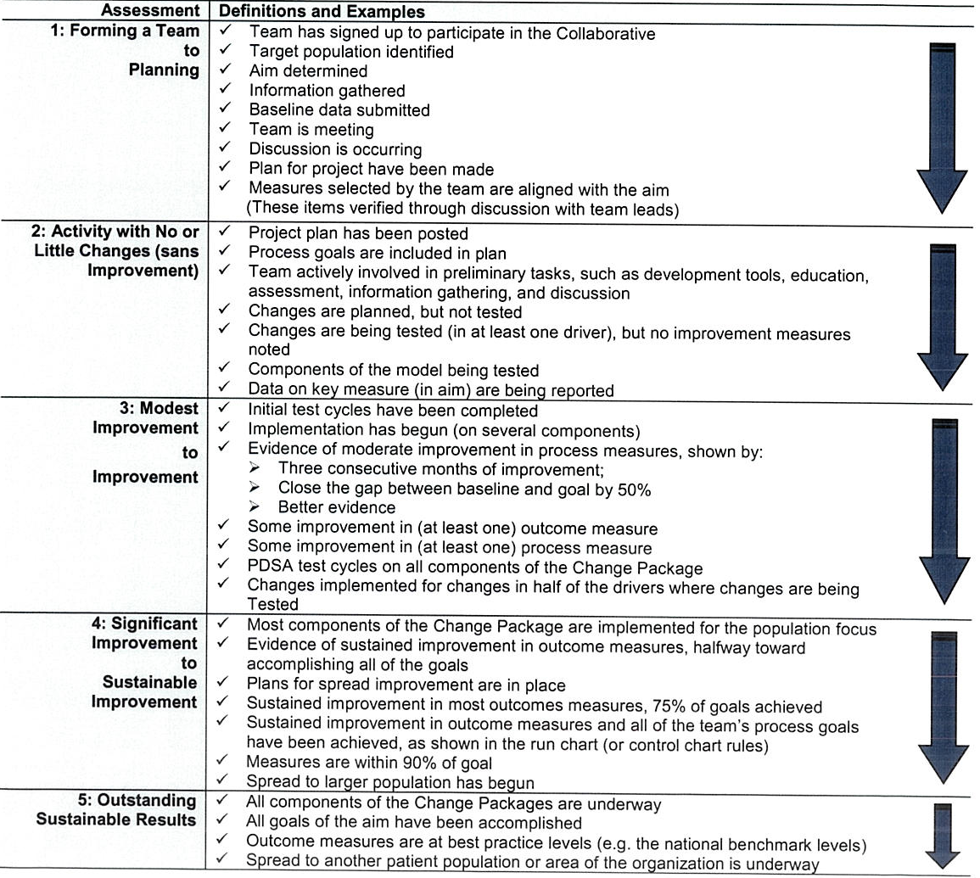

Slide 26

Approaching Opportunity
The tool we use to implement change is the PDCA cycle:
Plan- Identify and analyze the problem.
Do- Develop a solution
Check- Ensure the solution will truly correct the identified issue
Act- Implement the solution and follow the results. Adjust Accordingly

Slide 27
Getting Started in Our New HIIN
South Central HIINergy Partners
January 25, 2017
Discussion and Sharing
Facilitated by:
Jackie Conrad
Improvement Advisor
Cynosure Health
Discussion and Sharing
Resources
Next steps
Hospital Improvement Innovation Network

Slide 28

Discussion and sharing
Add an image that might inspire discussion and sharing.
South Central HIINergy Partners

Slide 29
Highlighted Resources
QHRET HIIN
Quality Improvement and
Patient and Family Engagement Fellowships
South Central HIINergy Partners

Slide 30
Quality Improvement Fellowships
HRET will be offering two Quality Improvement Fellowships for anyone in the HRET HIIN Hospital Network!
Registrants will be able to choose which fellowship most meets their needs and will have the opportunity to participate in each session virtually.
IHI faculty will be leading the sessions encouraging contributions from expert faculty and fellows. Fellows will also have access to the IHI Open School.
HRET will be offering certificates of completion to fellows who complete proposed criteria specific to the fellowships.

Slide 31
QI: Foundations for Change
Tailored to those who are new to quality improvement
Fellows will learn how to :
  Deploy tools such as aim statements, driver diagrams, and run charts to initiate and nurture improvement
  Galvanize others to participate in your improvement effort
  Mitigate common improvement pitfalls
  Develop and maintain momentum

Slide 32
QI: Accelerating Improvement
Tailored to those with previous QI experience who are looking to deepen their knowledge and skills
Fellows will learn how to :
  Assess whether your QI efforts are set up for success
  Utilize data to identify, drive, and sustain performance improvement
  Ensure process reliability and sustainability
  Plan for spread and scale

Slide 33
Next Steps
After adjusting for hospital characteristics, hospitals with improvement champions (P = .008), a higher level of engagement with their state association (P = .001), and more leadership involvement (P = .005) in HEN demonstrated greater improvement.”
Register yourself and encourage colleagues to register as well. Our goal is at least one fellow per HIIN hospital.
  Foundations for Change Accelerating Improvement Application
  Accelerating Improvement Foundations for Change Application
Fellowships start on January 18!

Slide 34
HRET HIIN
Patient and Family Engagement Fellowship
Overview

Slide 35
What is the PFE Fellowship?
A 9 month comprehensive, virtual PFE skill building, fun, interactive learning opportunity:
To develop skills and tools to work in authentic partnership with Patient and Families to improve quality, patient safety and patient experience
To work in collaboration with national PFE experts and colleagues
To network across the HRET HIIN with other organizations as we tackle barriers and celebrate successes

Slide 36
Fellowship Project
Putting PFE strategies to work improving care. For Example:
Adverse drug events
  PFA committee work
  TeamSTEPPS for Pts (Time-Out Tool)
  PFA Rounding
  Teach back

Slide 37
Fellowship Project (cont‘d)
Time Commitment
  Monthly webinars
  One additional monthly learning event
  Optional coaching
  About 3 hours a month + time spent on the project
Registration:
Sign up as a team including PFAs
Register Here

Slide 38
Past
Events
In case you missed it…
Visit topic-specific pages at www.hret-hiin.org
HIIN Virtual Events Recaps
The following virtual events recording has been posted to the HRET HIIN website:
Beyond The CAUTI Bundle: Addressing Cultures and Patterns of Care
https://www.youtube.com/watch?v=Sl8ic83K6Tc
HRET HIIN Falls Webinar: Teaming up to Jump the Gap in Falls
https://www.youtube.com/watch?v=TFGRKtTmSzY
HRET HIIN What if…We reduced Harm from ADE’s
https://www.youtube.com/watch?v=Wiz1Oqmh4-o
HRET HIIN Sepsis Virtual Event
https://www.youtube.com/watch?v=kmHEUm6-uFM
HRET HIIN C. Difficile Webinar Stubborn or Unreasonable
https://www.youtube.com/watch?v=-DID4zl7HFI
Hospital Improvement Innovation Network

Slide 39



Slide 40
State Contacts
Arkansas Hospital Association Pam Brown pbrown@arkhospitals.org 501-224-7878 | Missouri Hospital Association Alison Williams awilliams@mhanet.com (573) 893-3700, ext. 1326
Kansas Healthcare Collaborative Michele Clark mclark@khconline.org (785) 235-0763 x1321 | Oklahoma Hospital Association Patrice Greenawalt pgreenawalt@okoha.com (405) 427-9537
Louisiana Hospital Association Michelle Smith msmith@lhaonline.org (225)928-0026 | Texas Hospital Association Karen Kendrick kkendrick@tha.org (512)465-1091
South Central HIINergy Partners

